Slide 1

San Fransokyo Industries
Security Infiltration Drone Milestone One
EG-UY 1003 Section BY1
21st July 2015
Alice Ross - CFO
Jeremiah Nofrada - CTO
Jason Yao - CEO

Slide 2
Agenda
Project objective
Background information
Technical design description
Cost estimate
Project schedule
Summary

Slide 3
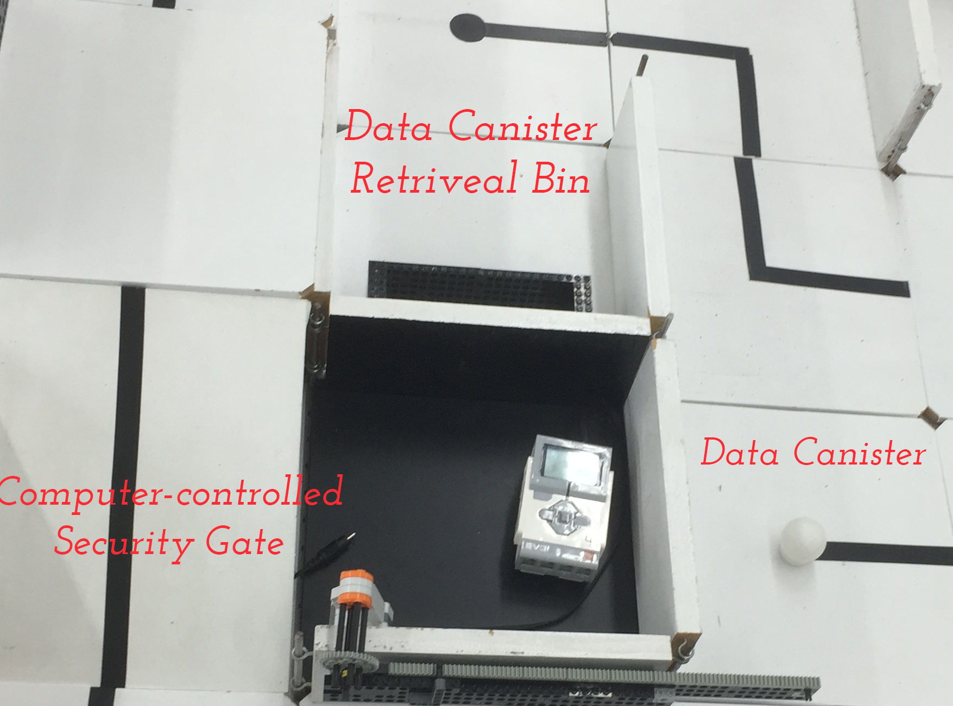
Project Objective
Mission description
Design & build robot prototype able to infiltrate CIA
Must move autonomously, deactivate all gates, reach extraction point
Bonus: retrieve data canisters, place in data retrieval bins

Slide 4
Project Objective
Overall approach
Common “checkpoints” set
Re-uses movements to checkpoint
Allows for modularity of code
Allows code re-use
Extra credit
Embedded into travel path
Disallows normal graph traversal

Slide 5

Background Information
CIA infiltrated in 2009, CIA issues Request For Proposal for robot for infiltration & data retrieval

Slide 6
Technical Design Description
Robot moves autonomously
Follows pre-set path
Programmed with Mindstorm
Sensors
Barcode scanner to open gates
Arm for data canister retrieval

Slide 7
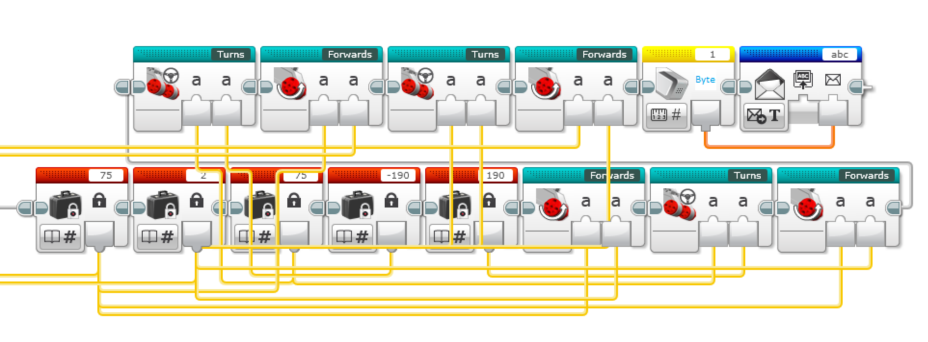
Technical Design Description
Mindstorms program (Checkpoint 1)

Slide 8
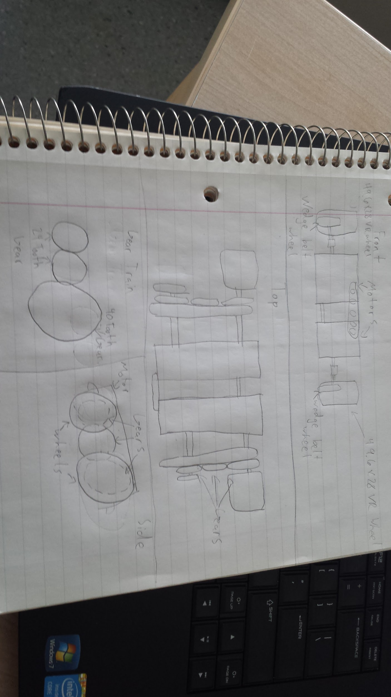
Technical Design Description
Front View
Side view
Top view
Gear Train

Slide 9
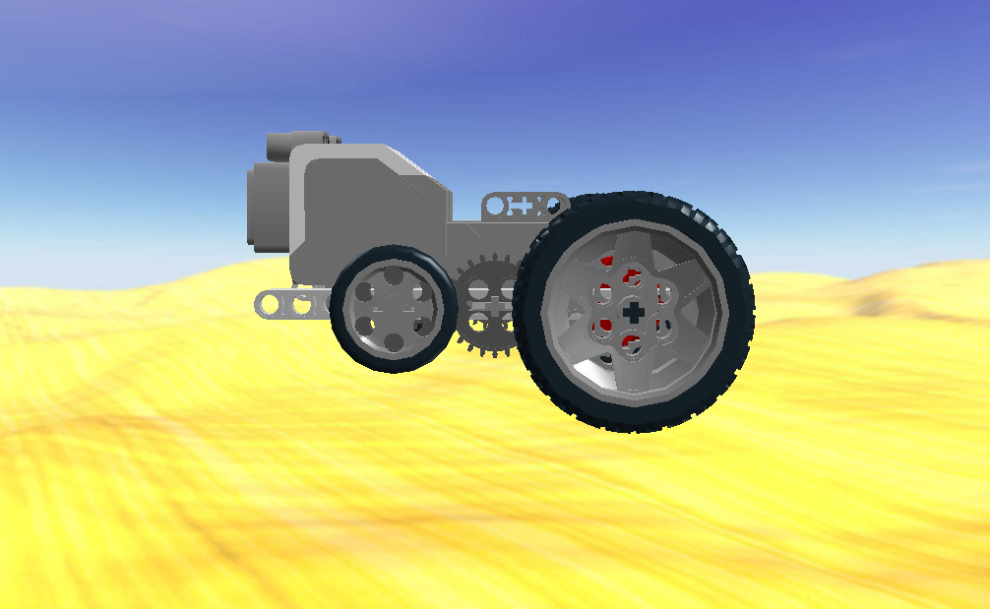
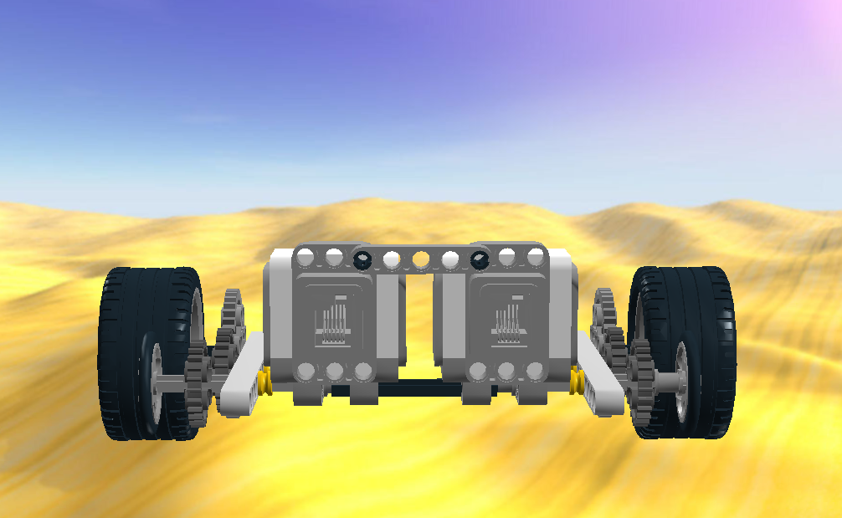
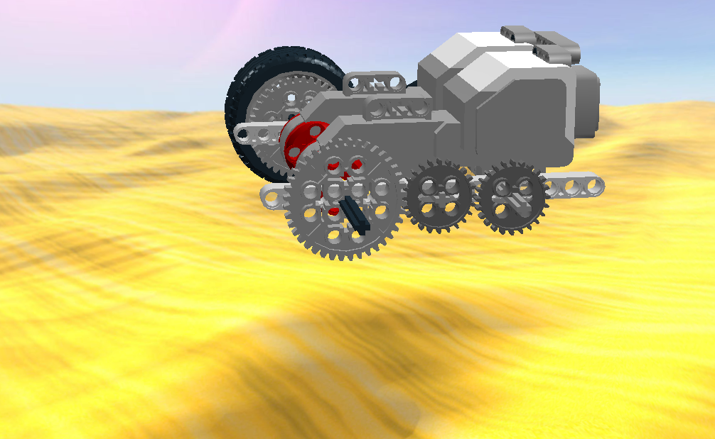
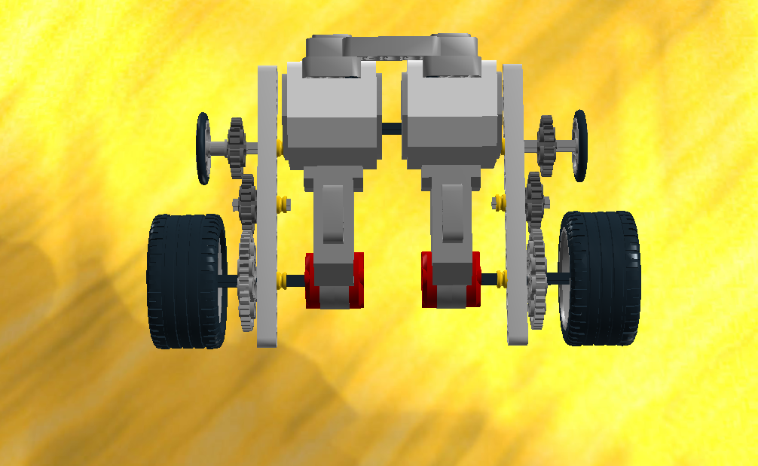
Technical Design Description
Front view
Side view
Top view
Gear Train

Slide 10
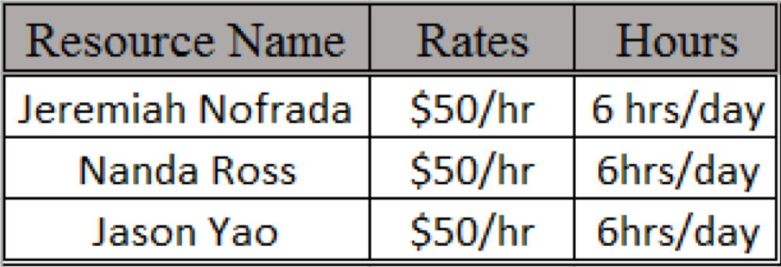
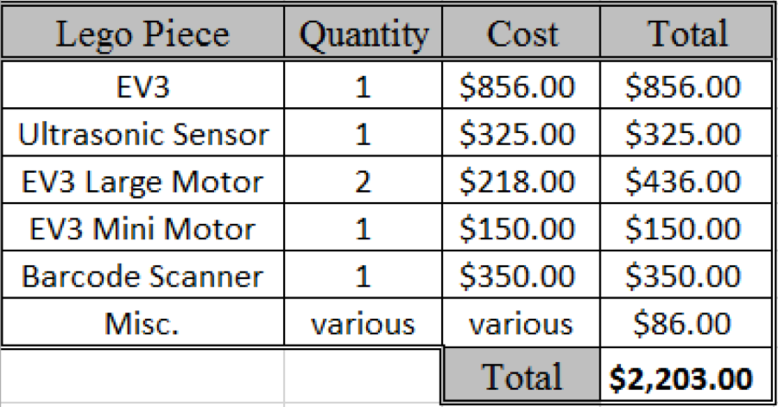
Cost Estimate
Labor costs
Lego piece costs

Slide 11
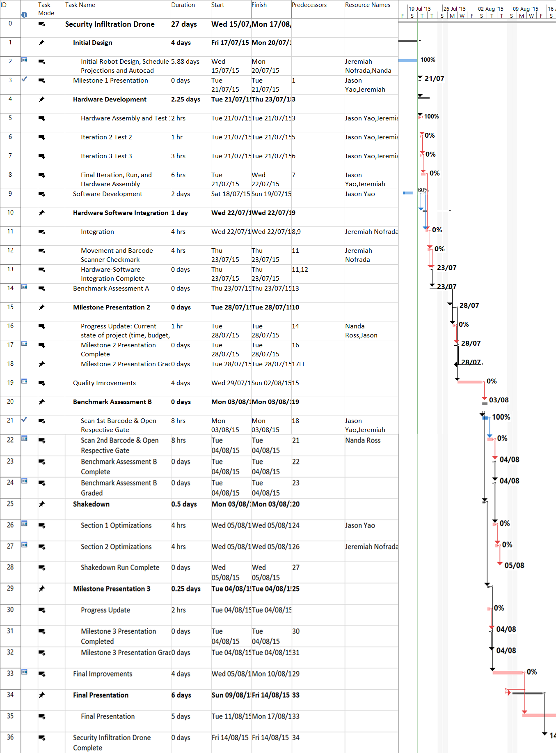
Project Schedule
Initial design complete
Milestone 1 presentation complete
Software - 50% done
Prototyping - 60% done
Benchmark A software & hardware completed

Slide 12
Summary
Overall assessment
Ahead of schedule
Prototype near completion
Cost assessment
Costs in line with projections
Activities to be done for next milestone
Physical prototype
Updated software

Slide 13
Works Cited
NYU Polytechnic School of Engineering. 2011. “Lab 03: Product Evaluation and Quality Improvement.” EG 1003 Online Lab Manual. Accessed 14 July 2015 from manual.eg.poly.edu.

